Slide 1






SELL MORE
UNDERSTANDING CUSTOMER’S
DECISION BEHAVIOR WITH MODERN
MACHINE LEARNING MODELS

Slide 2

01
PROGRESS
WHAT WE HAVE DONE LAST WEEK?
PART ONE
PART TWO
PART THREE
PART FOUR
01
02
03
04
Get familiar with machine learning
Explain the
scikit-learn model
Understand the different type of model and visualization
Integrate framework

Slide 3


02
USER STORY
As a system user, I want to view all the data-set which I can use in the shell so that I can choose a data-set as input data.
01
02
As a system user, I want to fetch the data-set in the shell so that I can see the detailed information of this data-set.
User Story
03
04
As a system user, I want to choose the features and labels of the data-set I fetched before so that I can do the machine learning for this data.
As a system user, I want to train the data so that I can see the difference between train score and test score.

Slide 4
03
ROLES

Slide 5
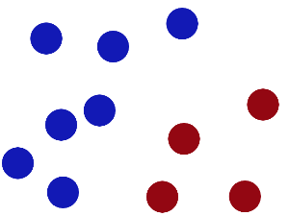
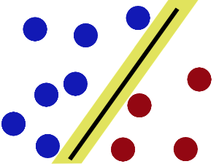
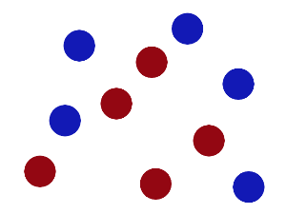

04
MACHINE LEARNING MODEL: SVM
01
02
SVM
03
04

Slide 6
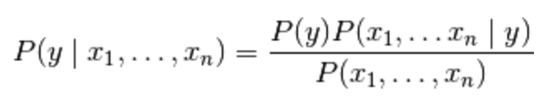
04
MACHINE LEARNING MODEL – NAÏVE BAYES
Problem:
The probability of a League of Legends player:
Male
25 years old
Bachelor degree
Stop playing League of Legends.
Naïve:
Based-on Naïve assumption,
which is the assumption of independence between every pair of features.

Slide 7
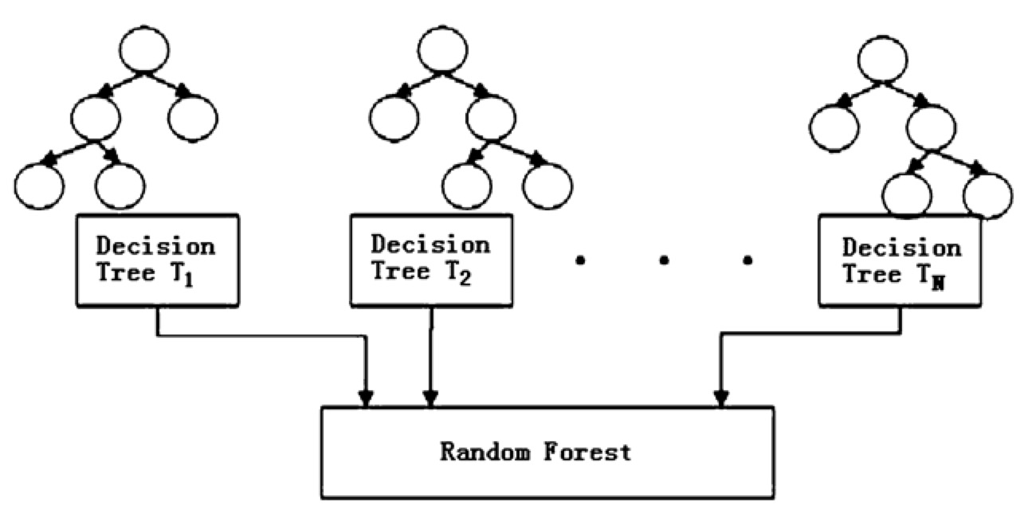

04
MACHINE LEARNING MODEL: RANDOM FOREST
Constructed by many decision trees
Reduce overfitting
Great prediction performance

Slide 8
05
INFLUENCE FUNCTION
Purpose: implement high-performance and explainable model
Definition:
A classic technique from robust statistics
Suitable for multiple purpose

Slide 9
06
DATA VISUALIZATION
Raw data
Data visualization
Graph
A third-party python library for data visualization
Easy to use: far easier than d3.js
“If we use d3.js, we probably need to write 200 lines code to draw a plot diagram ”
“Only 10 lines for matplotlib”
High performance:
No need to export data to another program

Slide 10
07
SCHEDULE
WEEK | SCHEDULE
Week 1-2 | Understand our problems Define problems Use models
Week 3-6 | Find the source code and implement it Testify the implementation
Week 7-10 | Collect data to justify the theory Visualize the results
Week 11-12 | Write reports Write development documents

Slide 11
PPT模板下载：www.1ppt.com/moban/ 行业PPT模板：www.1ppt.com/hangye/
节日PPT模板：www.1ppt.com/jieri/ PPT素材下载：www.1ppt.com/sucai/
PPT背景图片：www.1ppt.com/beijing/ PPT图表下载：www.1ppt.com/tubiao/
优秀PPT下载：www.1ppt.com/xiazai/ PPT教程： www.1ppt.com/powerpoint/
Word教程： www.1ppt.com/word/ Excel教程：www.1ppt.com/excel/
资料下载：www.1ppt.com/ziliao/ PPT课件下载：www.1ppt.com/kejian/
范文下载：www.1ppt.com/fanwen/ 试卷下载：www.1ppt.com/shiti/
教案下载：www.1ppt.com/jiaoan/ PPT论坛：www.1ppt.cn
SELL MORE
PROCEED TO
DEMONSTRATION
Your life can be enhanced, and your happiness enriched, when you choose to change your perspective.

